Slide 1
CSS Corners, Borders and Shadows
Jose Andres Giron Giron
WDD 230
BYUi

Slide 2

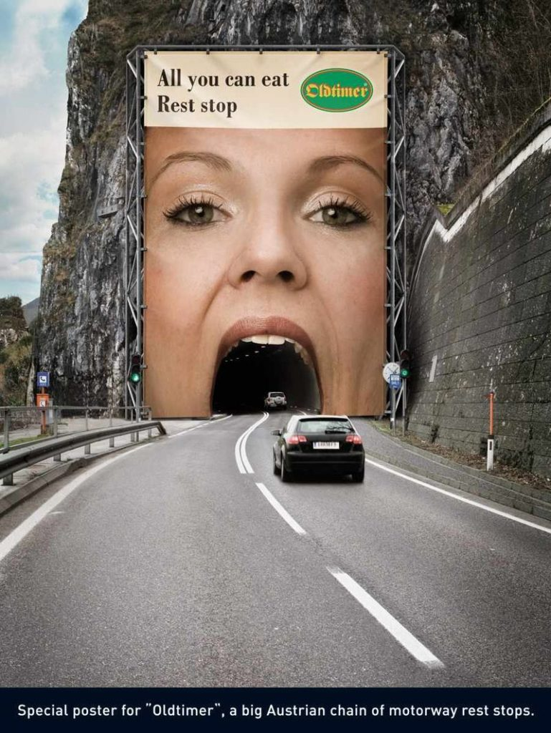
Why?
Notes:
Why? We want to grab users´ attention to our site. The better our design is, the more attention we will have from the user. Design to grab the user´s attention. Make your design attractive and striking in the users´ eyes and you will be able to get more out of your websites.
CSS Corners, Borders and Shadows can help you make various elements stand out. The shadow effect in the mouth that this ad has is great.

Slide 3
CSS Corners
The border-radius is a shorthand for the following CSS properties:
border-top-left-radius
border-top-right-radius
border-bottom-right-radius
border-bottom-left-radius
Notes:
The CSS Border-radius property allows you to add rounded corners to elements!

Slide 4
CSS Corners Syntax
/*Radius is set for all 4 sides*/
border-radius: 10px;
/* top-left | top-right-and-bottom-left | bottom-right */
border-radius: 2px 4px 2px;
Notes:
1 parameter. Applies the radius to each and every corner.
2 parameters: top-left + bottom-right and a top-right + bottom-left.

Slide 5



CSS Corners Syntax
Notes:
3 parameters: top-left, to top-right and bottom-left and to bottom-right. 4 parameters. Clockwise order, starting with top-left.

Slide 6
Borders
The border property is a shorthand property for:
border-width
border-color
/*If border-color is omitted, the color applied will be the color of the text*/
border-style (required)
Notes:
border-width Specifies the width of the border. Default value is "medium“

Slide 7
Border-style
Specifies the style of the border. Default value is "none“
Values:
Solid
Dotted
Dashed
Inset
Outset
Ridge
Groove
Double
none
Hidden

Slide 8
Shadow
With CSS you can add shadow to text and to elements.
text-shadow
box-shadow

Slide 9
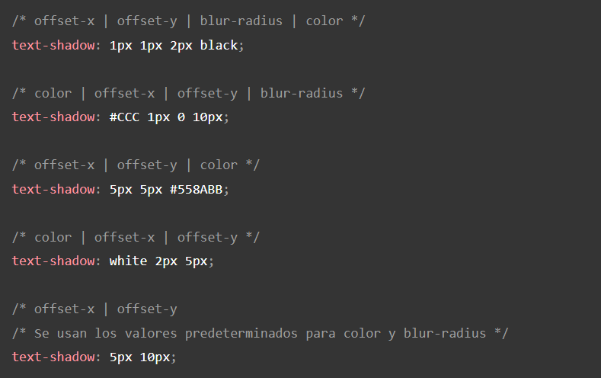
text-shadow
Notes:
In its simplest use, you only specify the horizontal shadow (2px) and the vertical shadow (2px): Since for most of us English is not our native tongue let me bring to the table the meaning of offset: “the amount or distance by which something is out of line”

Slide 10
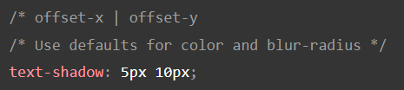
text-shadow
Notes:
In its simplest use, you only specify the horizontal shadow (2px) and the vertical shadow (2px): Since for most of us English is not our native tongue let me bring to the table the meaning of offset: “the amount or distance by which something is out of line”

